Slide 1
CSF 2113 Programming for Information Security
CLO3: Web-Application-Interaction
Muhammad Humayoun, PhD
Assistant Professor
mhumayoun@hct.ac.ae
Abu Dhabi Men’s College
This module is based on the course: Learning Python Web Penetration Testing, www.lynda.com

Slide 2
Table of Contents
HTTP protocol basics
Anatomy of an HTTP request
Interacting with web applications using Request library
Analyzing the responses
Exploring headers

Slide 3
HTTP protocol basics
What is HTTP and how it works
HTTP: The Hypertext Transfer Protocol
HTTPS: Adding security layer to HTTP
HTTP methods
This will provide you with the basic knowledge about HTTP, which is important to understand how to build tools and test for security issues in Web applications.

Slide 4
What is HTTP and how it works
HTTP is designed to enable communications between clients and the servers
A TCP/IP based communication protocol operating in the application layer
HTTP is a Media independent protocol
Any type of data can be sent by HTTP, as long as the client and the server know how to handle the data content.
HTTP is Stateless
The HTTP server and the clients are aware of each other during the requested transaction only
Due to this characteristic, neither the client or the server retain information between requests
Hackers can use this characteristic to perform some attacks
Notes:
Normally, we use a Web browser to interact with Web applications. But in this module, we will leave the browser behind, and we are going to use Python to talk with Web applications.

Slide 5
What is HTTP and how it works
HTTP protocol is available in two different versions
HTTP/1.0
Uses a new connection for each request response transaction
HTTP/1.1
the connection can be used by one or more request response transactions
HTTP is clear text and usually is served on port 80
Not a secure protocol, and vulnerable to interception and tampering

Slide 6
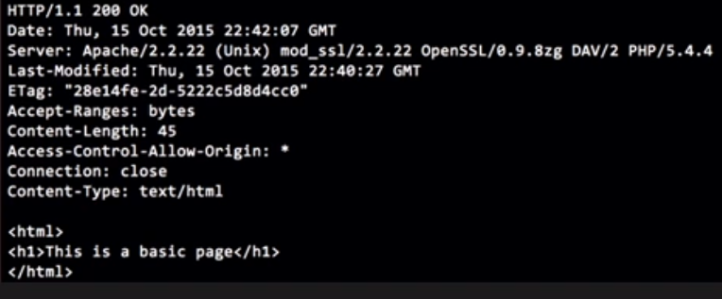
What is HTTP and how it works
An example of what a simple transaction looks like
This represents the most basic GET request in the Web application world
Sends an HTTP GET request to the server, asking for the resource test.html
GET /packt/test.html HTTP/1.0
Client /
Browser
Server
If the resource exists on the server:
Returns an HTTP response with a 200 okay code, some headers and the content test.html
If the resource does not exist:
It will return a 404 not found response code
Source: Learning Python Web Penetration Testing, Lynda.com

Slide 7
HTTPS: Adding security layer to HTTP
HTTPS was introduced by Netscape to add security on top of HTTP in 1994
HTTPS = HTTP over SSL (and later over TLS)
SSL: Secure Socket Layer; TLS: Transport Layer Security
HTTPS creates a secure channel over an insecure network
This ensures reasonable protection from eavesdroppers, and man-in-the-middle attacks, provided that adequate cryptographic algorithms are used, and that the server certificate is verified and trusted.
Usually served on port 443
HTTPS must be used whenever the application handles sensitive information
Notes:
In 1994, HTTPS was introduced to add security on top of HTTP.
HTTPS is not a protocol itself, but the result of layering HTTP on top of SSL or TLS.
So, whenever the application handles the sensitive information, it should use HTTPS. Banking payments, shopping websites, login pages, profile pages, et cetera. Basically, if we handle, process, or store customer data, it should use HTTPS.

Slide 8
HTTP Methods
Methods (verbs) = desired action to be performed
HTTP = GET, POST, and HEAD
GET: method used to retrieve resource content, given a URI
POST: method used to submit content to the server, forms data, files, etc.
HEAD: only returns the headers and the status code without its content

Slide 9
Anatomy of an HTTP request
URL Structure
Headers
GET request

Slide 10
URL Structure
Resource/file path
- directory is content
- resource is section
Host
http://www.packtpub.com/content/section?id=1&topic=2
query string
id and topics are parameters that will be passed to the section page for processing purposes
Protocol
There are some alternatives like adding username and password for authentication before the host or explicitly defining the port for cases where the web server is not listening in the standards 80 or 443 ports.
Notes:
It's now time to stop and think about the URL structure. Let's see what each part means. The first part is the protocol in web applications. The two protocols used are HTTP and HTTPS. When using HTTP, the port that will be used is 80. And when using HTTPS, the port will be 443. The next part is the host we want to contact.

Slide 11
HTTP Headers
Headers describe how the client and the server can talk to each other and also provide information about the transaction
Core part of HTTP requests and responses
Client side headers (sent by the browser):
User-agent
this informs a server what type of OS, browser, plugins the users have
Accept-language
Content-Type
Accept-encoding
which encoding the browser supports, usually gzip or deflate
This will compress the content and reduce the bandwidth time for transaction
Host
the Internet host to whom to want to connect
Referer
Referer contains the referer URL, basically from which page you clicked that link
Cookies
If our browser has cookies for a site it will add them in the cookie header

Slide 12
HTTP Headers
Server side headers (set by the web server):
Cache-Control
the directives which must be obeyed by all caching mechanisms along the chain
Content-Type
Custom headers
Location
used for redirections
Whenever there is a 301or 302 response, the server must send this header
Set-Cookies
used to set a cookie in the users’ browser
WWW-Authenticate
When the browser sees this header, it will open a login window asking for the username and password
Notes:
Code 301 : Moved Permanently
Code 302 : Moved Temporarily

Slide 13
Interacting with web Applications using Requests library
Request Library
Performing requests using Request
GET request
Setting headers
POST request

Slide 14
Request Library
REQUESTS is an Apache 2 licensed HTTP library written in Python
The website we shall use is http://www.httpbin.org/
It is just like a mirror:
Whatever we send to this server, it sends us back
For teaching and testing purpose

Slide 15
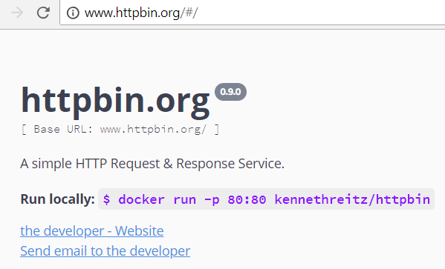
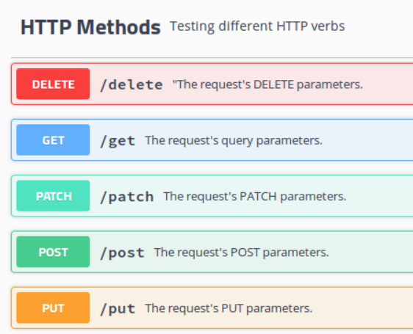
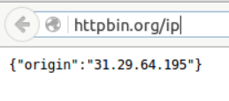
www.httpbin.org Web Service
http://httpbin.org/ is a simple HTTP Request & Response Service
Developed For teaching and testing purpose
In your browser try this url:
http://httpbin.org/ip
Sends to back your IP in JSON format

Slide 16
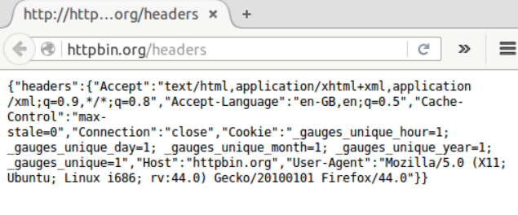
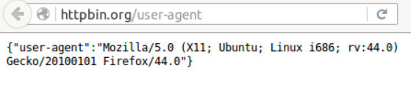
www.httpbin.org Web Service
Now try these urls:
http://httpbin.org/headers
http://httpbin.org/user-agent

Slide 17
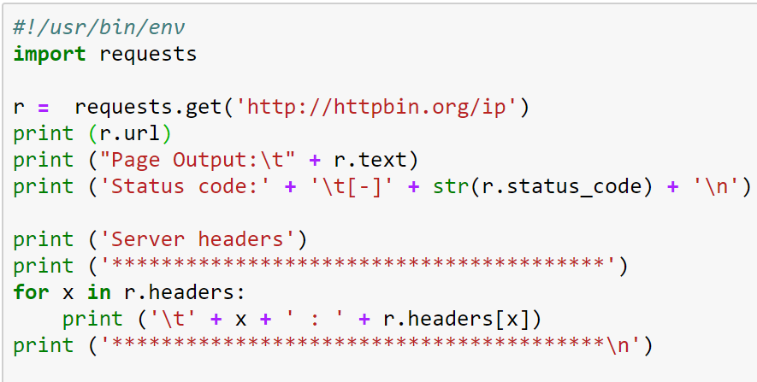
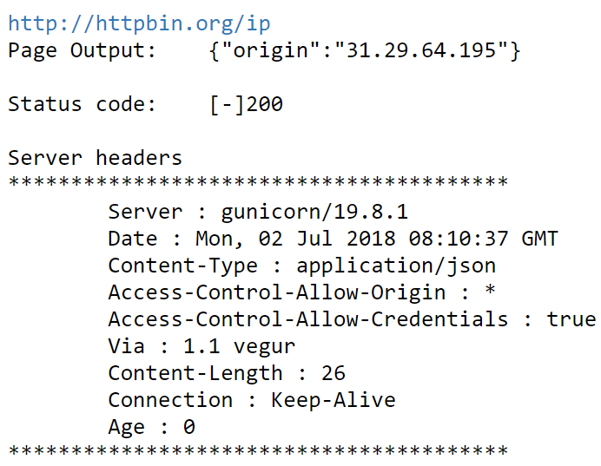
Performing a GET request using Request
get a url
Status code 200 means that page found
r.headers is a dictionary containing key:value pairs such as:
{Server: gunicorn/19.8.1, …, Age:0}

Slide 18
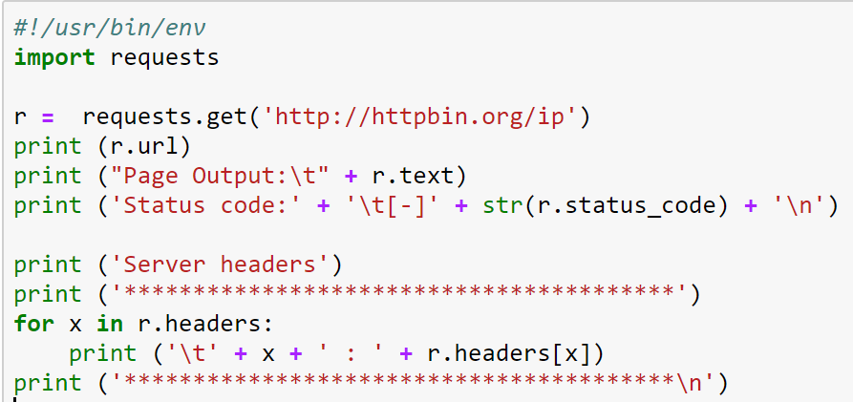
Performing a GET request using Request
Print values of r.headers line by line using for loop

Slide 19
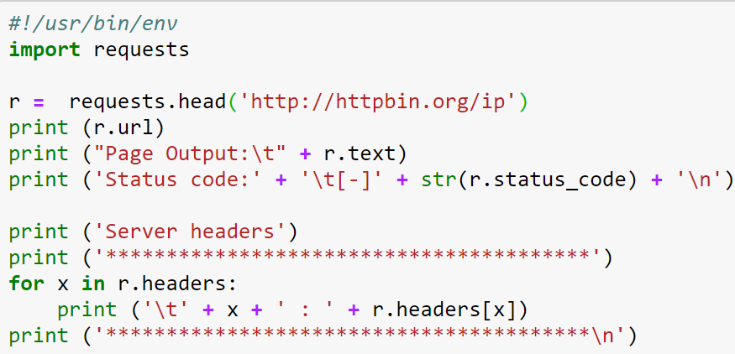
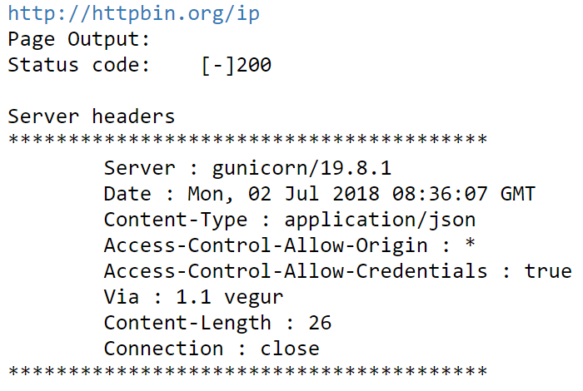
Head instead of GET
change get method to head.
With head we get headers from the server
We can see the status code being 200, and we are getting back the headers, but we don't have the response body content anymore

Slide 20
Settings Headers
Custom headers
how to set the headers of a request
Headers expected by the servers and various application
Why do this?
To trick the server into thinking that we are a something else (e.g. a mobile device)
Fake our user-agent
Change the Host header
To see how the server or application handles it (to find vulnerabilities)
Bruteforce or tamper any header
Notes:
Now we're going to see how to set the headers of a request. Why would we want to do that? Because we may need to add custom headers expected by the application. We want to fake our user-agent to trick the server into thinking that we are a mobile device.
We may want to change the Host header to trick the server or load valances. Or we may want to bruteforce, or tamper with a header value, and see how the application handles it.

Slide 21
Get your header information from Browser
Visit http://httpbin.org/headers
The server knows who I am because my Brower sent this info to the server:
For instance, the information about my browser (i.e. “User-Agent” is Mozilla/5.0 …)
Let us get it from Python
{"headers":{"Accept":"text/html,application/xhtml+xml,application/xml;q=0.9,image/webp,image/apng,*/*;q=0.8","Accept-Language":"en-US,en;q=0.9,fr;q=0.8,fr-FR;q=0.7,ur;q=0.6","Cache-Control":"max-stale=0","Connection":"close","Dnt":"1","Host":"httpbin.org","Upgrade-Insecure-Requests":"1","User-Agent":"Mozilla/5.0 (Windows NT 10.0; Win64; x64) AppleWebKit/537.36 (KHTML, like Gecko) Chrome/67.0.3396.87 Safari/537.36"}}

Slide 22
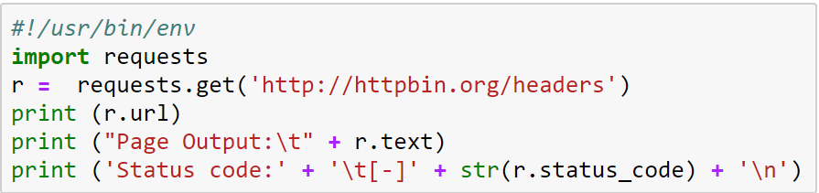
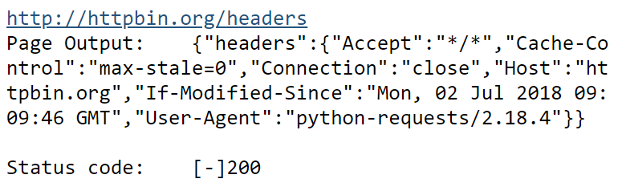
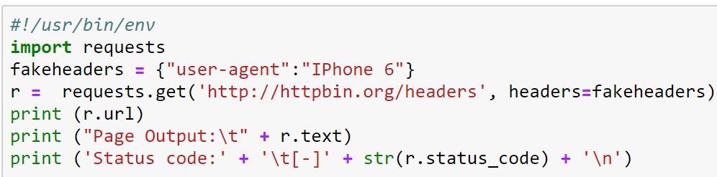
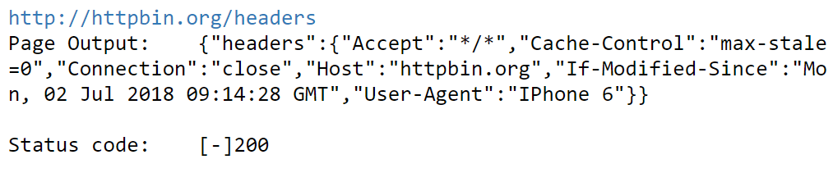
Get your header information from Python
Change user-agent to “IPhone 6”
Using key:value of dictionary

Slide 23
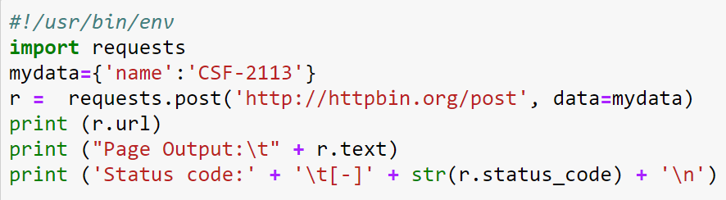
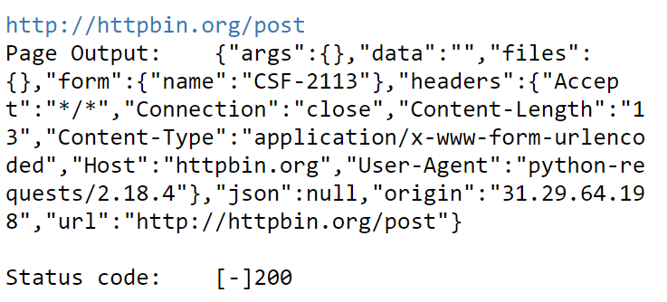
POST request
POST request allows to send form parameters
Change GET to POST
Visit the post resource www.httpbin.org/post and add the data dictionary. This is typically the form data you see in a web application.

Slide 24
Analyzing the server’s responses
HTTP codes
Successful responses
Client-side error responses
Redirection responses

Slide 25
HTTP codes
1XX – Informational
2XX – Success
3XX – Redirection
4XX – Client-side errors
5XX – Server-side errors
See https://developer.mozilla.org/en-US/docs/Web/HTTP/Status
https://en.wikipedia.org/wiki/List_of_HTTP_status_codes
https://www.w3.org/Protocols/rfc2616/rfc2616-sec10.html

Slide 26
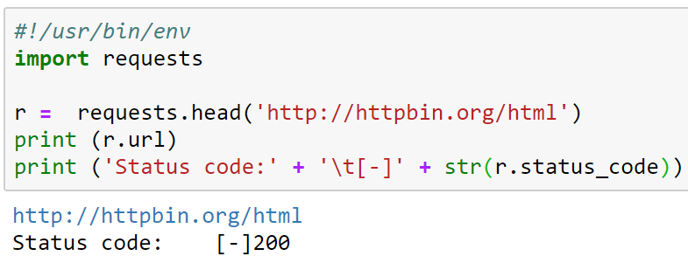
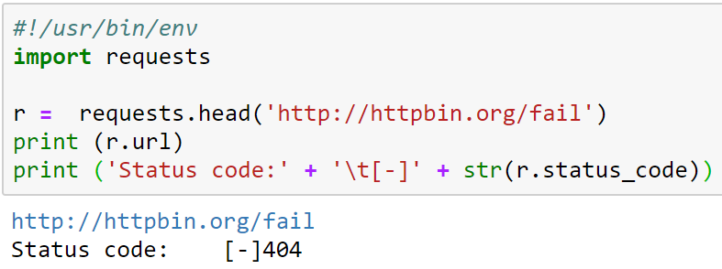
A simple hack
200 Resource found
404 Resource not found
It means that we can ask the server for a list of directories and files, and find which one exist or not.
Interesting, right?

